Slide 1
Design and Implementation of a Wireless Fall Detection Network Prototype using MEMS sensors
Ho Ngoc Khang Minh - Matriculation number: 1148602
1st Supervisor: Prof. Dr. –Ing Kira Kastell
2nd Supervisor: Dipl –Ing. Mohammad Reza Mansooji
Frankfurt am Main, September 2018

Slide 2
AGENDA
Introduction to falls
Causes and Consequences of falls
Literature Review
Objectives
Methodology and Algorithm
System Intergration
Data Collection
Result
Discussion

Slide 3
Introduction to falls
1 in 3 people with
Every 19 minutes
200 falls result in
ONE
faller dies
65+ years old
fall once per year
hip fracture

Slide 4

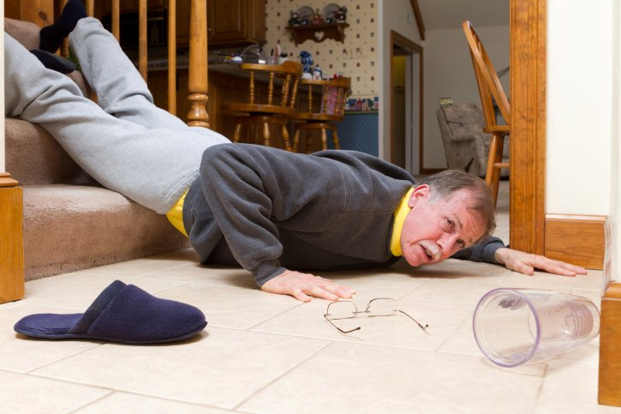
Causes of a fall
Intrinsic factors
Cognitive Impairment
Postural control
Cardiovascular problem
Extrinsic factors
Dim lighting or glare
Bad staircase design

Slide 5
Consequences of falls
Physical consequences
Hip fractures
- A quarter million hip fractures occur each year
Half of them cannot live independently
$3 billions for medical treatment
Head Injuries
- 10 – 15% admission to the hospital because of head injuries caused by falls
Death
- 36.8 / 100 000 people die every year because of falls

Slide 6
Consequences of falls
Psychological consequences
Fear of falling again prevents them from their daily activity
Stop going out or physical activities
Increase the risk of falling because of physical function attenuation

Slide 7
Consequences of falls
Other consequences
Dependency
Some cannot live independently
Need long-term nursing care
Hospital admission
- In England (1998), 200 000 people of 65+ are treated
Economic burden
- In U.S. (2015), $50 billion being used for fall injuries
- Expected to reach $67.7 billion by 2020

Slide 8
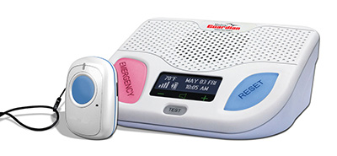
Literature Review
Existing Commercial Devices
- Including one base station & one neck pendant
When detecting a fall, pendant send signal to base
- If the patient actually needs help, not press button
- Automatically contact with monitoring center
- $44.95 / month
Fig 1. Medical Guadian Fall Alert System [1]

Slide 9
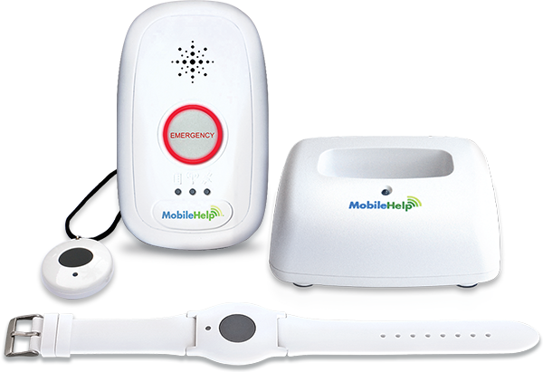
Literature Review
Existing Commercial Devices
- Detect fall
- Monitoring heart rate
- Sleep/wake pattern
- Location of patient
- Cellular network
- $41.95 / month
Fig 2. myHalo Medical Alert System [2]

Slide 10
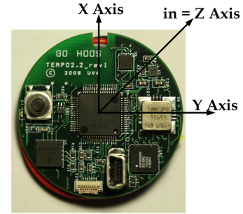
Literature Review
Existing Research
+ From Qiang Li and colleagues
+ Including one gyroscope and one accelerometer
+ Combines data from both sensor
- Difficulty in differentiate jumping into bed and
falling against a wall
Fig 3. Tempo 3.0 sensor node [3]

Slide 11
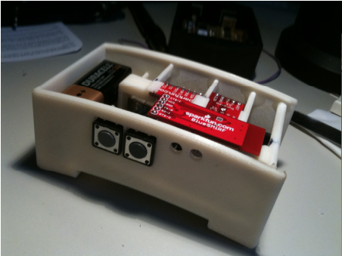
Literature Review
Existing Research
+ From Binh Nguyen & Tomkun
+ Use only one accelerometer
+ Automatically call 911 when detecting
a fall
+ Visual LED indicator
- Some action cannot be distinguished by
propose algorithm
Fig 4. Product of Binh Nguyen’s group [4]

Slide 12
Project objective
Design a falling detection network
1
Sending alert signal to care-givers by email
2

Slide 13
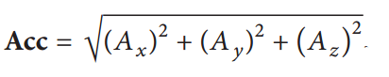
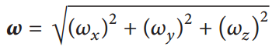
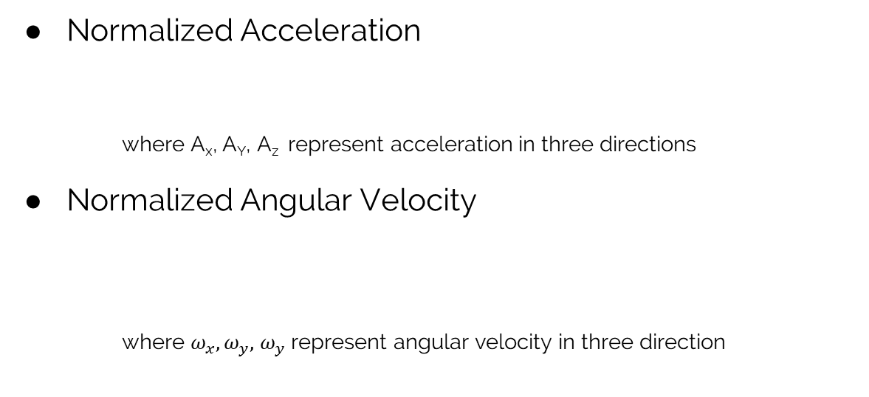
Methodology & Algorithm
Normalized Acceleration
where A_{x}, A_{Y}, A_{z} represent acceleration in three directions
Normalized Angular Velocity
where $ω_{x}, ω_{y},$ $ω_{y}$ represent angular velocity in three direction

Slide 14
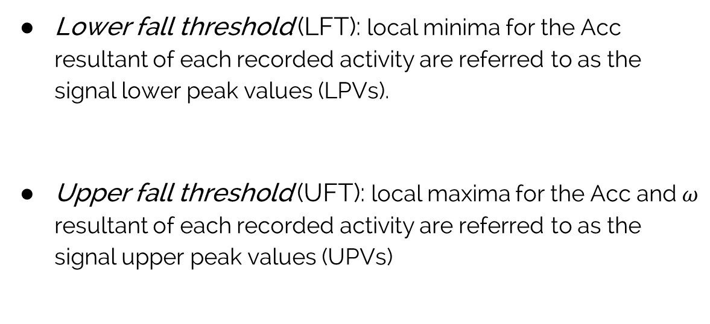
Algorithm
Lower fall threshold (LFT): local minima for the Acc resultant of each recorded activity are referred to as the signal lower peak values (LPVs).
Upper fall threshold (UFT): local maxima for the Acc and $ω$ resultant of each recorded activity are referred to as the signal upper peak values (UPVs)

Slide 15
Algorithm
3 Threshold Types
LFT_{Acc} : lower limit for acceleration
UFT_{Acc} : upper limit for acceleration
UFT_{Gyro}: upper limit for angular velocity

Slide 16
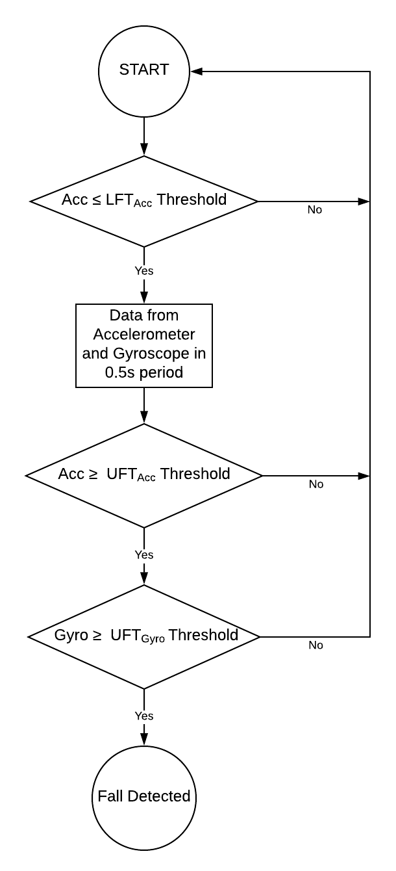
Algorithm
*Nominated by Quoc T. Huynh et. al. [7]

Slide 17
SYSTEM OVERVIEW

Slide 18
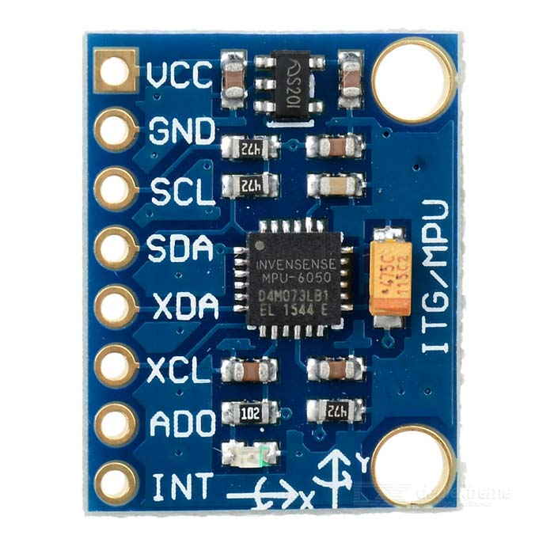
SENSORS
Inertia Measurement Unit (IMU) - MPU6050
Accelerometer
full-scale range of ±2g, ±4g, ±8g,
and ±16g.
Gyroscope
full-scale range of ±250, ±500, ±1000,
and ±2000 °/sec (dps)
Fig 5. MPU-6050 sensor [5]

Slide 19
DATA FUSION
Sensors Characteristics
Accelerometer
Sensitive with any sudden small force
Data is reliable in long term
Gyroscope
Drift over time
Give accurate information, not affected by
external force
Fig 5. MPU-6050 sensor

Slide 20
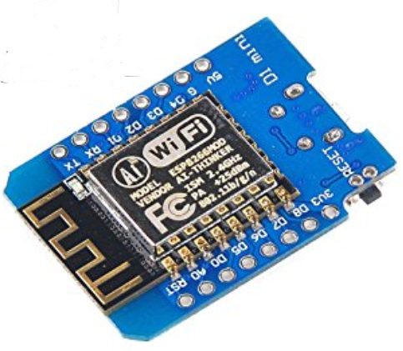
MICRO-CONTROLER
ESP8266EX
- L106 32-bit RISC processor
- Maximum clock speed 160Mhz
- Supports GPIO, UART, I²C, ADC, etc.
- 50kB RAM and 16MB SPI flash
Fig 5. ESP8266EX

Slide 21
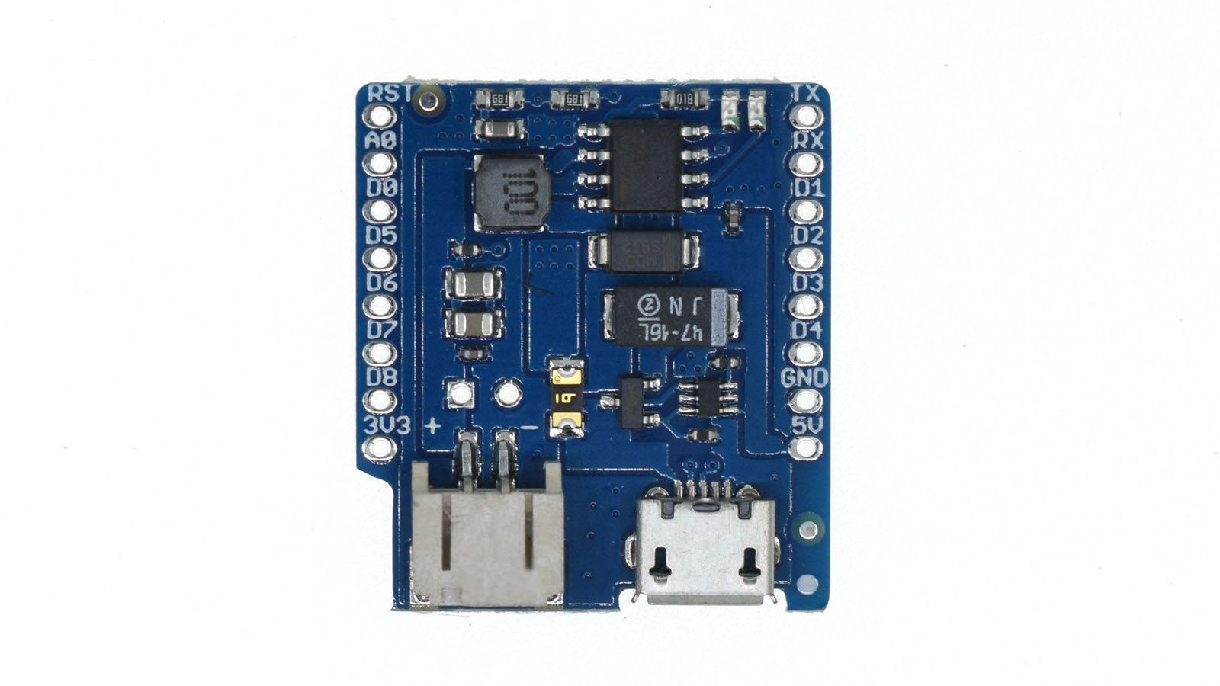
POWER SUPPLY
ESP8266 Power Supply Shield
- Compitable with ESP8266 board
- Provide 5V power supply
- Support Lithium Battery
- Allow battery charging
Fig 6. ESP8266 power shield

Slide 22
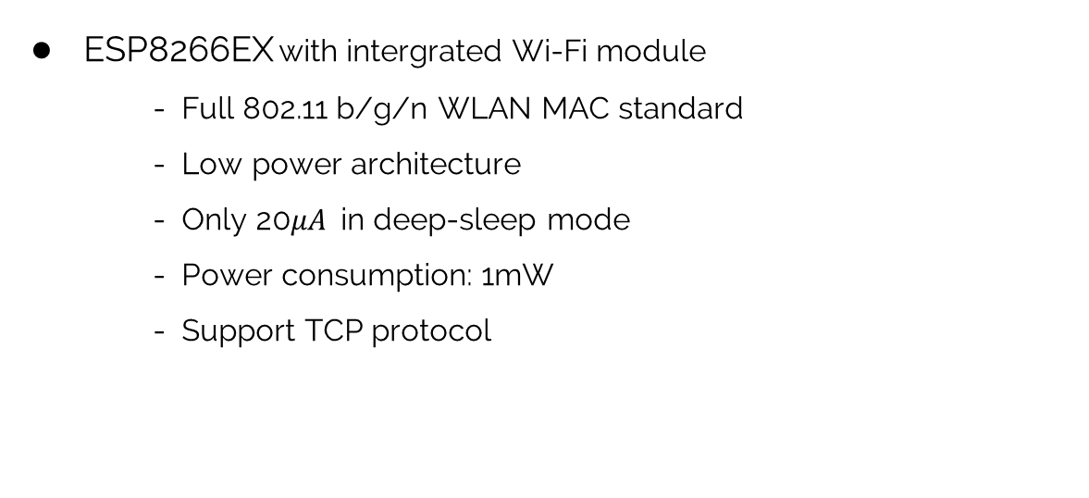
COMMUNICATION
ESP8266EX with intergrated Wi-Fi module
- Full 802.11 b/g/n WLAN MAC standard
- Low power architecture
- Only 20$μA$in deep-sleep mode
- Power consumption: 1mW
- Support TCP protocol
Fig 7. ESP8266 WiFi module

Slide 23
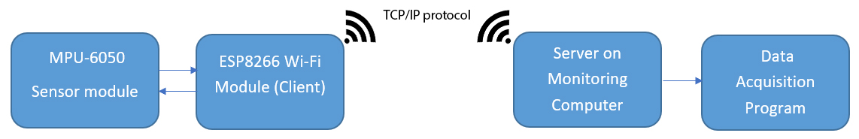
COMMUNICATION
Fig 8. Communication protocol

Slide 24
SOFTWARE
Embedded Software
- Read data from sensor
- Calculate normalized values
- Concatenating data into message
- Sending data to host computer

Slide 25
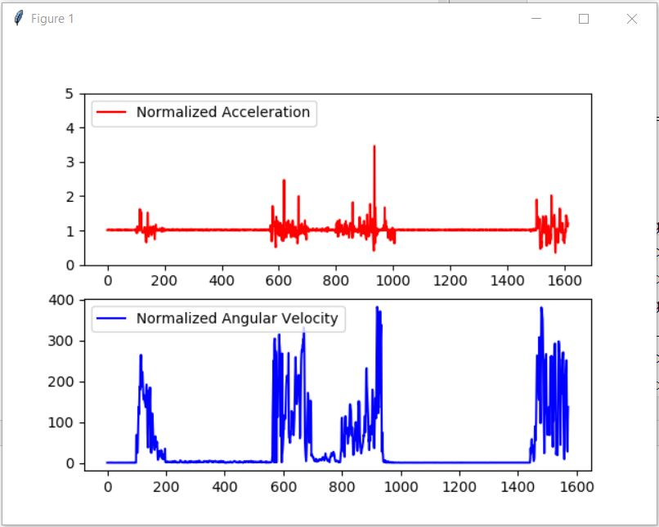
SOFTWARE
Data acquisition software
- Running a server
- Read data from received message
- Visualize data
- Store data into CSV file
Fig 9. Data acquisition software

Slide 26
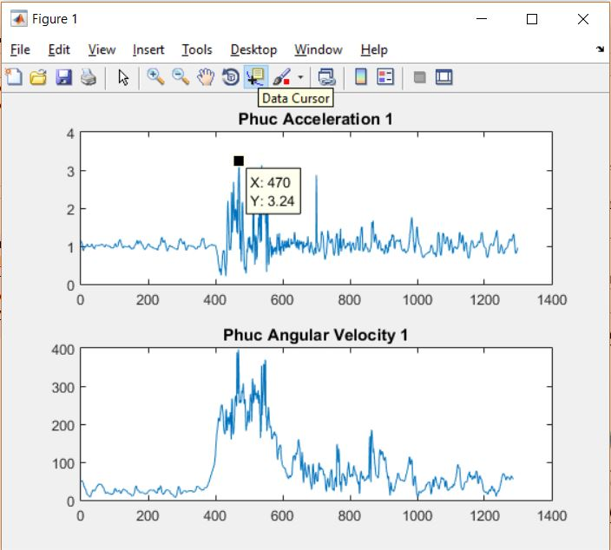
SOFTWARE
Data analysis software: MATLAB
- Reading data from CSV file
- Load data to MATLAB array
- Plotting data
- Analyze data with provided tools
Fig 10. Data analysis software

Slide 27
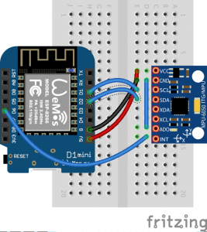
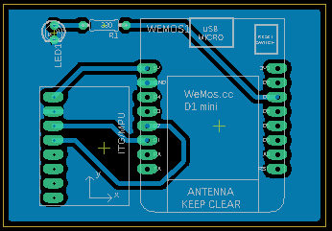
SYSTEM INTEGRATION
Fig 11. Wiring schematic of MPU-6050 [6]
Fig 12. Printed Circuit Board Design

Slide 28
EXPERIMENTS

Slide 29
EXPERIMENT
5 volunteers were asked to perform different movements:
- standing up
- sit down
- walking
- running
- lying on the bed
- going up/down stair
- jumping
- different fall tests: forward, backward, right/left side way

Slide 30
EXPERIMENT
Detail body information of volunteers
SUBJECT | AGE | HEIGHT | WEIGHT (KG) | GENDER
S1 | 22 | 167 | 55 | Male
S2 | 22 | 179 | 71 | Male
S3 | 22 | 170 | 90 | Male
S4 | 22 | 178 | 65 | Male
S5 | 22 | 175 | 75 | Male

Slide 31
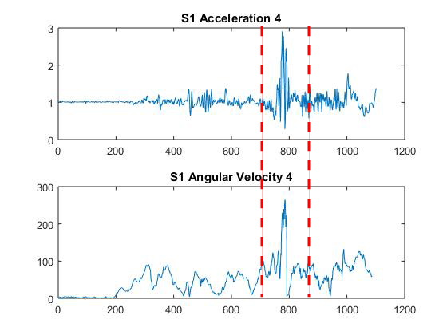
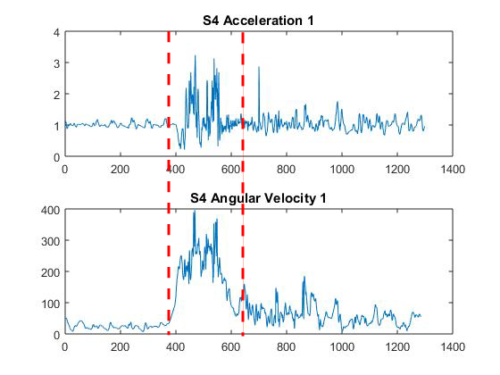
DATA ANALYSIS
Fig 13. S1 falls forward
Fig 14. S4 falls right side way

Slide 32
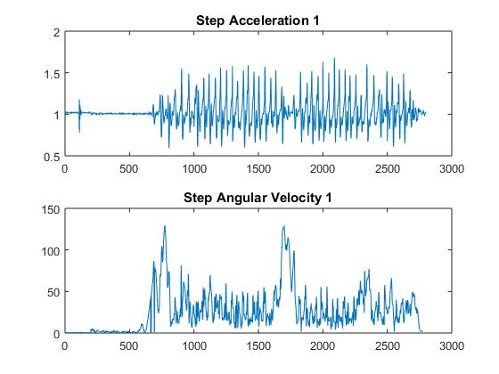
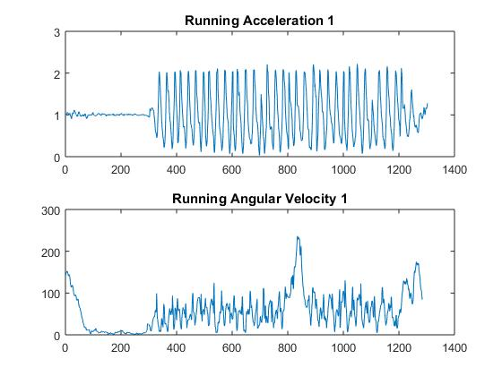
DATA ANALYSIS
Fig 15. Walking
Fig 16. Running

Slide 33
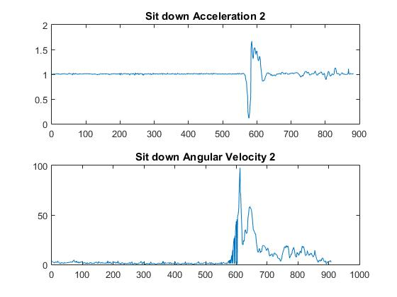
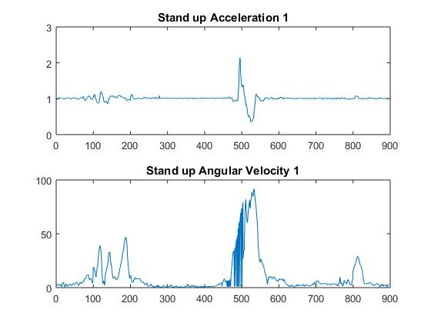
DATA ANALYSIS
Fig 17. Sitting down
Fig 18. Standing up

Slide 34
THRESHOLDS FINDING
Lower Fall Threshold for Accleration (LFT_{Acc}): 0.35 g
Upper Fall Threshold for Acceleration (UFT_{Acc}): 2.75 g
Upper Fall Threshold for Angular Velocity (UFT_{Gyro}): 254º/s

Slide 35
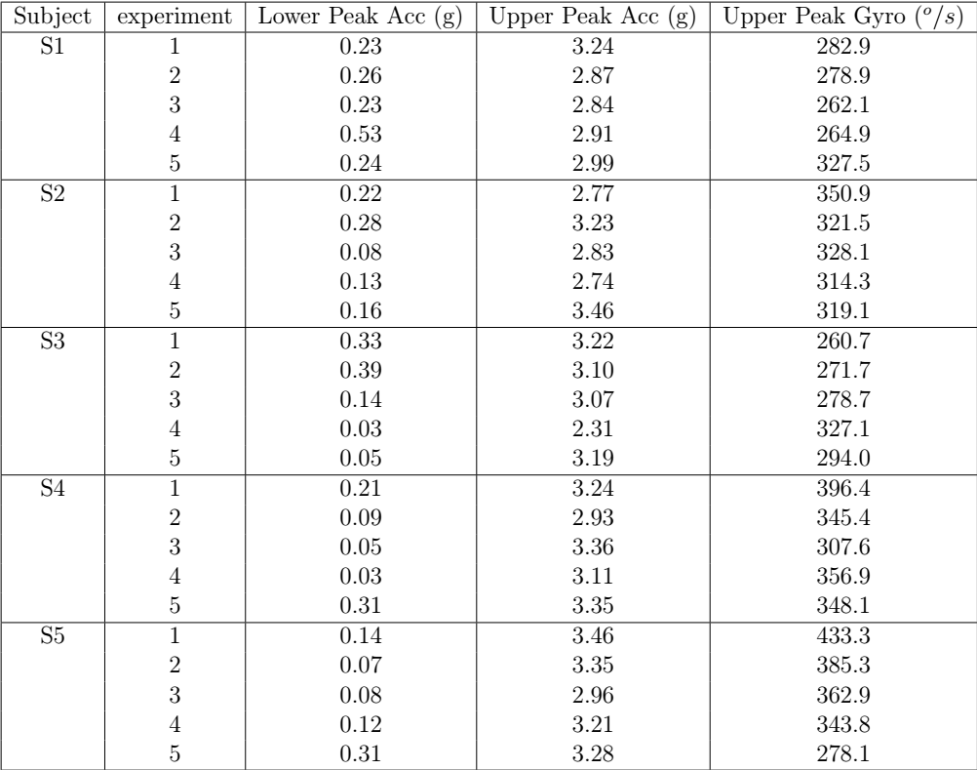

Slide 36
RESULTS

Slide 37
RESULTS
True Positive | False Positive | True Negative | False Negative | Total | Accuracy
6 | 2 | 8 | 4 | 14/20 | 70%
Fig 20. Experimental results
True positive: fall occurs, device detects it
False positive: device detects fall, fall does not occur
True negative: normal movement, device does not declare a fall
False negative: fall occurs, device does not detect it

Slide 38
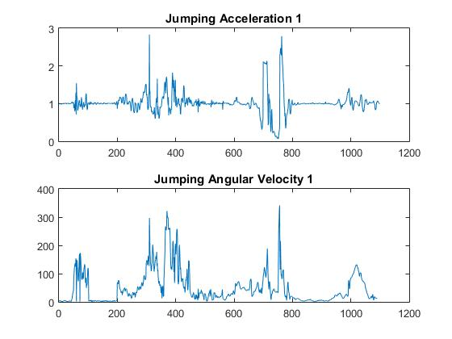
RESULTS
False positive
Fig 21. Jumping with strong force on the ground

Slide 39
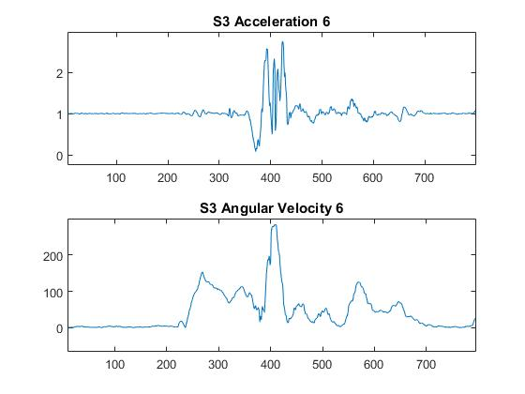
RESULTS
False Negative
Fig 22. Delay of normalized acceration cause false negative

Slide 40
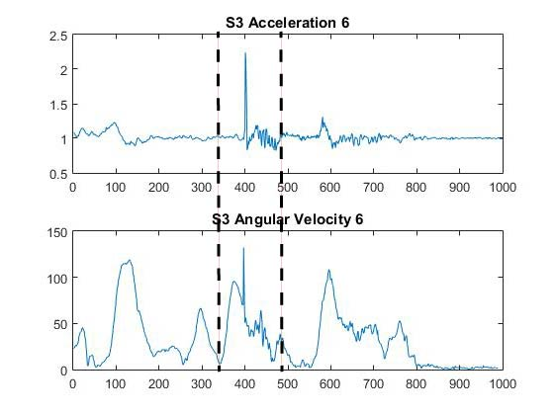
RESULTS
False Negative
Fig 23. Fall happens, acceleration does not fall below LFT_{Acc}

Slide 41
SUMMARY
Studying about falls and their consequence
Developing a fall detection network to detect a fall and inform the caregivers on-time
Collecting data of different movements and falls
Data analysis
Choosing thresholds
Testing the robustness of the network

Slide 42
FURTHER DEVELOPMENT
Adaptive threshold method
→ Improve the accuracy of the system
Mobile platform
→ Easier and more convenient to use
→ Easier charging with mobile phone
Improve the reliability of system with data collected on different people with different physical conditions.

Slide 43
Reference
[1] How medical alert systems can help alzheimers & dementia patients." [Online]. Available: http://medicalalertsystemshq.com/guides/how-medical-alert-systems-can-help-alzheimers-dementia-patients.html [2] [Online]. Available: https://www.mobilehelp.com/medical-alert-systems/mobilehelp-solo/
[3] Q. Li, J. A. Stankovic, M. Hanson, A. Barth, and J. Lach, \Accurate, fast fall detection using gyroscopes and accelerometer-derived posture information," in Wearable and Implantable Body Sensor Networks, Berkeley, CA, USA, Jun. 2009 [4] J. Tomkun and B. Nguyen, Design of a Fall Detection and Prevention System for the Elderly," Bachelor Thesis, McMaster University Hamilton, Ontario, Canada, 2010.
[5] MPU-6050 Accelerometer + Gyro." [Online]. Available: https://playground.arduino.cc/Main/MPU-6050
[6] Testing mpu6050 before embarking on project." [Online]. Available: https://wifienabler.com/tag/mpu6050/ [7] Q. T. Huynh, U. D. Nguyen, S. V. Tran, and B. Q. Tran, Optimum location for sensors in fall detection," Proceedings of the International Conference on Green and Human Information Technology, 2013

Slide 44
Thank you for your listening.

